Slide 1

Final
Presentation
Rutwik Kulkarni, Kyle Mitchell, Ankit Mittal

Slide 2
Agenda
Problem Statement
Project Objectives
Project Outcomes
Questions

Slide 3
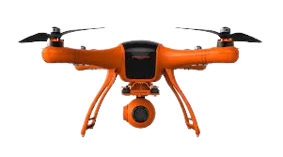
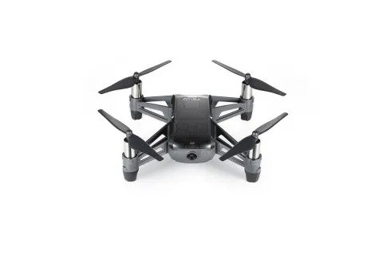
Problem Statement
Develop a drone trajectory system that combines path planning and dynamic optimization for smooth, practical flight paths. The aim is to create continuous routes through waypoints, focusing on smooth motion, time efficiency, and reliable velocity control.

Slide 4
Project Objectives
Phase 1: Geometric Path Planning using RRT and Informed RRT*
Efficiently generate an initial collision-free path through complex 3D environments using RRT* and Informed RRT*.
Ensure the path adheres to the drone's kinematic constraints and environmental boundaries.
Phase 2: Trajectory Generation and Optimization
Transform the geometric path into a smooth trajectory by minimizing snap (4th derivative of x), thereby ensuring fluid motion.
Optimize the trajectory in terms of segment times for efficient traversal between waypoints.
Create a trajectory that can be accurately followed by the drone, considering its dynamic capabilities and limitations.
Phase 3 : Implementation on Real Hardware.
Translate the optimized trajectories into executable flight paths on an actual drone and adapt the system for effective velocity control.

Slide 5
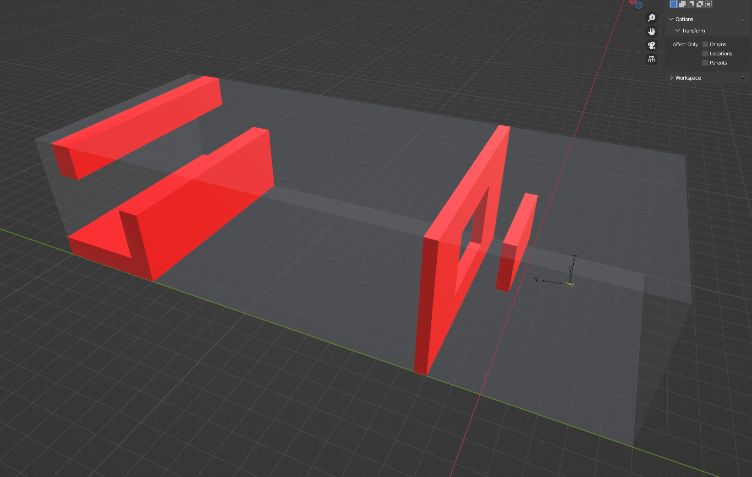
Blender Environment

Slide 6
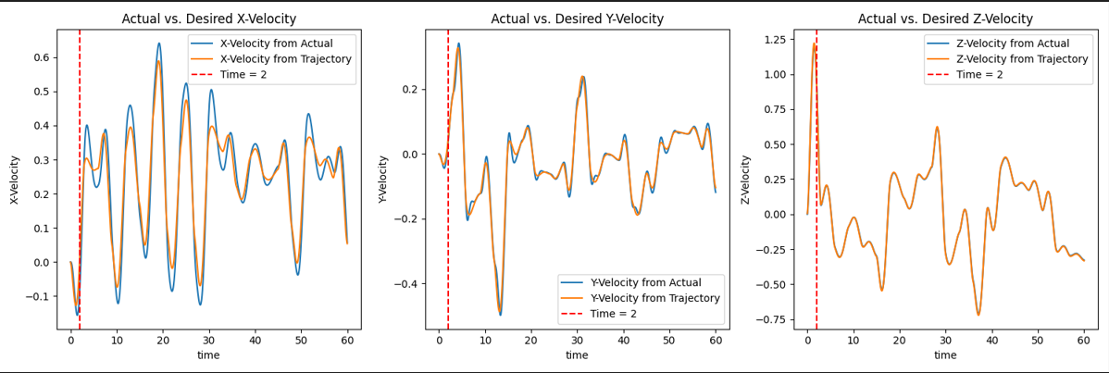
CONTROLLER - Cascaded PID Controller

Slide 7
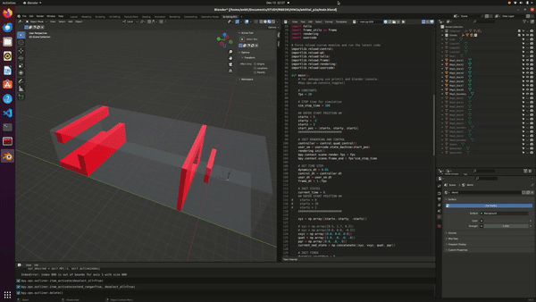
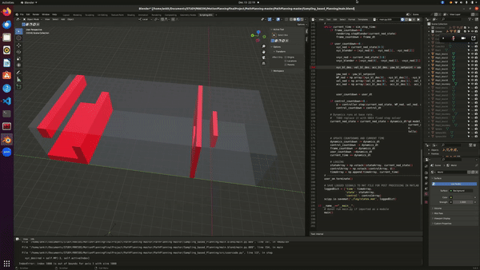
RRT* vs IRRT*

Slide 8
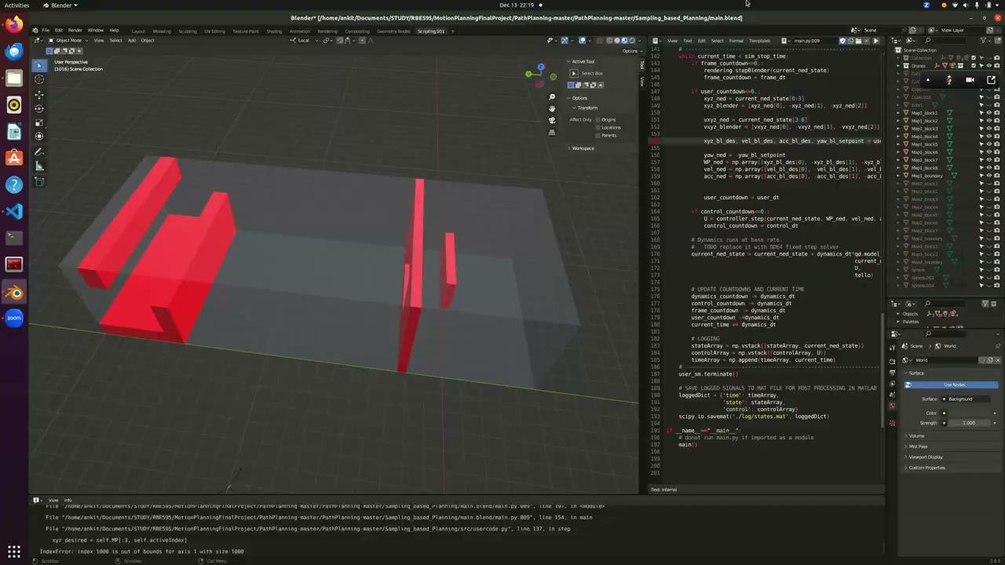
3x

Slide 9
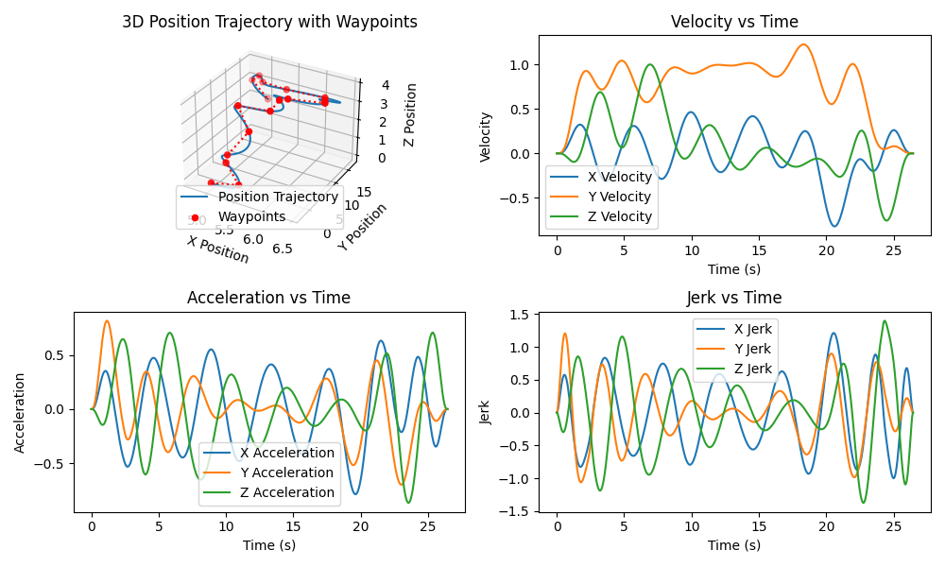
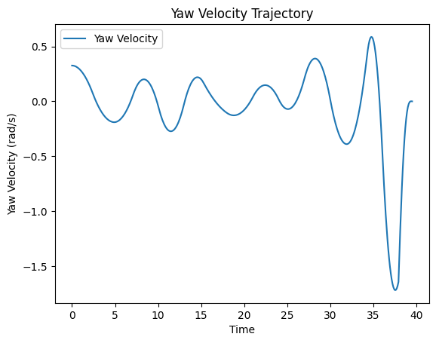
Trajectory Generation and Optimization using 10th Order Polynomial (Minimizing Snap)
[Richter 2016]Charles Richter, Adam Bry et Nicholas Roy. Polynomial trajectory planning for aggressive quadrotor flight in dense indoor environments. In Robotics Research, pages 649–666. Springer, 2016.

Slide 10
Real World Test

Slide 11
Hardware Used in Project: DJI Tello EDU
Model : DJI Tello EDU
Specifications :
Flight Time : ~13 mins
Range: 100 meters
Weight : Approx. 87 grams
Programming : Supports Python
Features :
Advanced Flight Control System
Suitable for Research Purposes
Library Used :
DJItellopy
Functionality :
Python Library for drone control
Supports drone manipulation

Slide 12
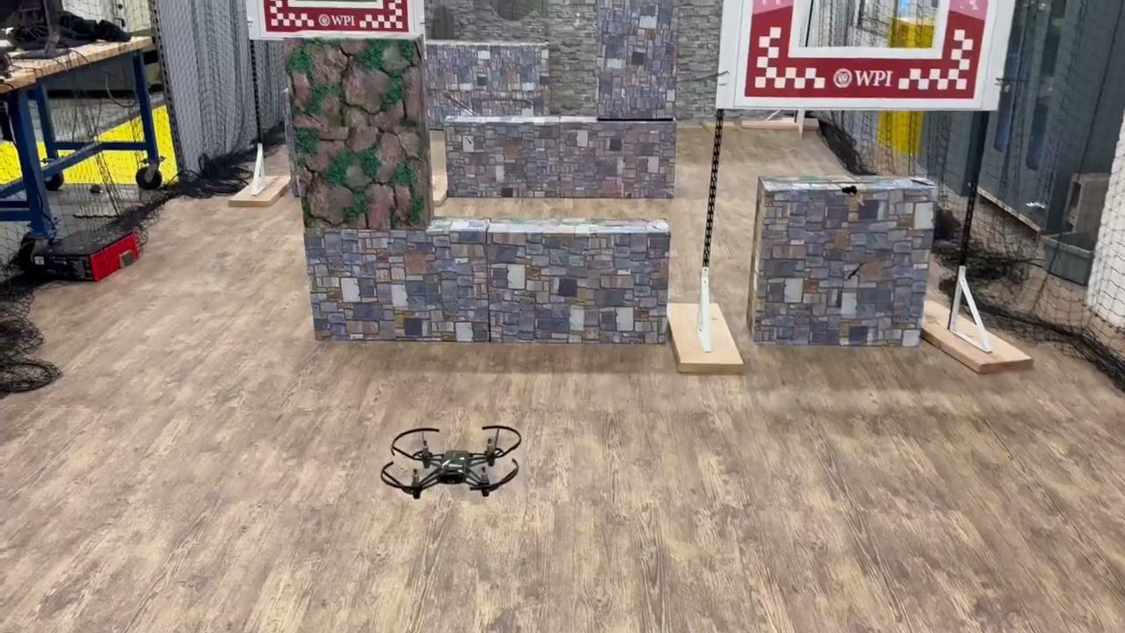

Slide 13
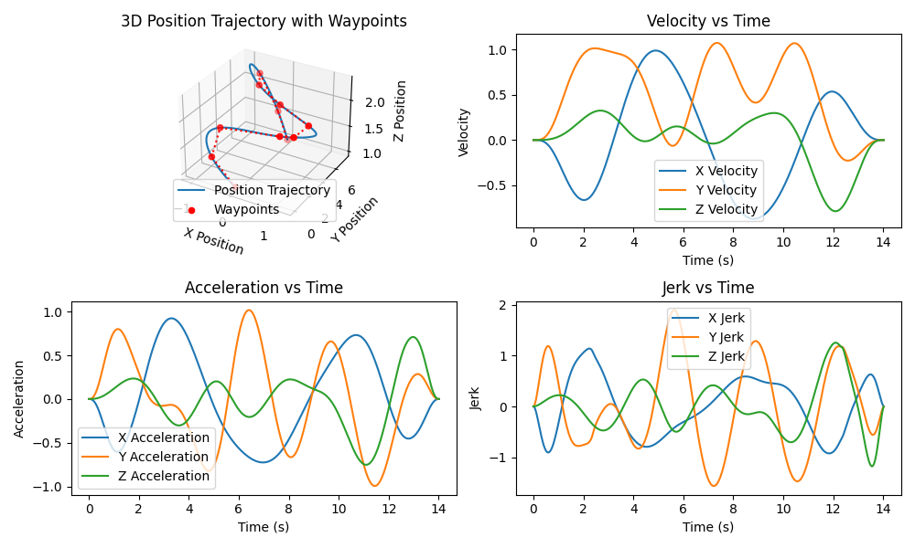
Plots for the Real World Test

Slide 14
Questions?

Slide 15
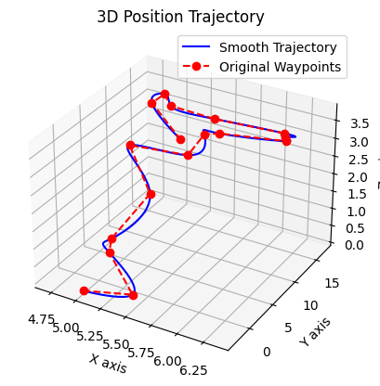

Slide 16
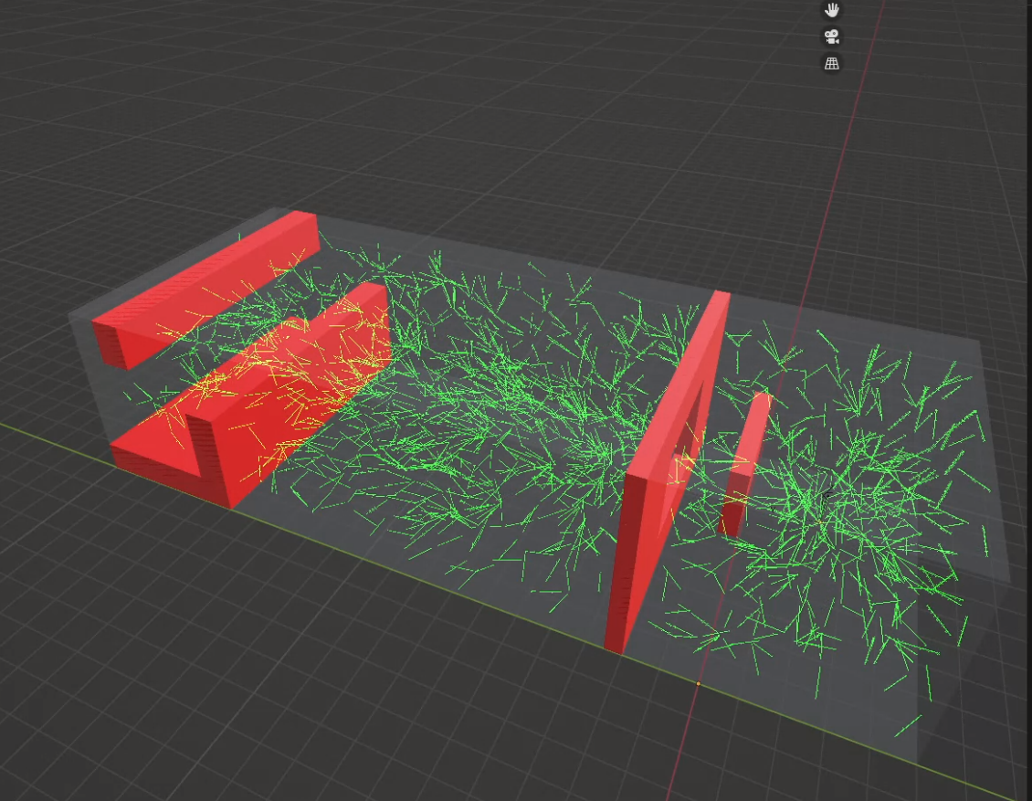
RRT* Visualization

Slide 17
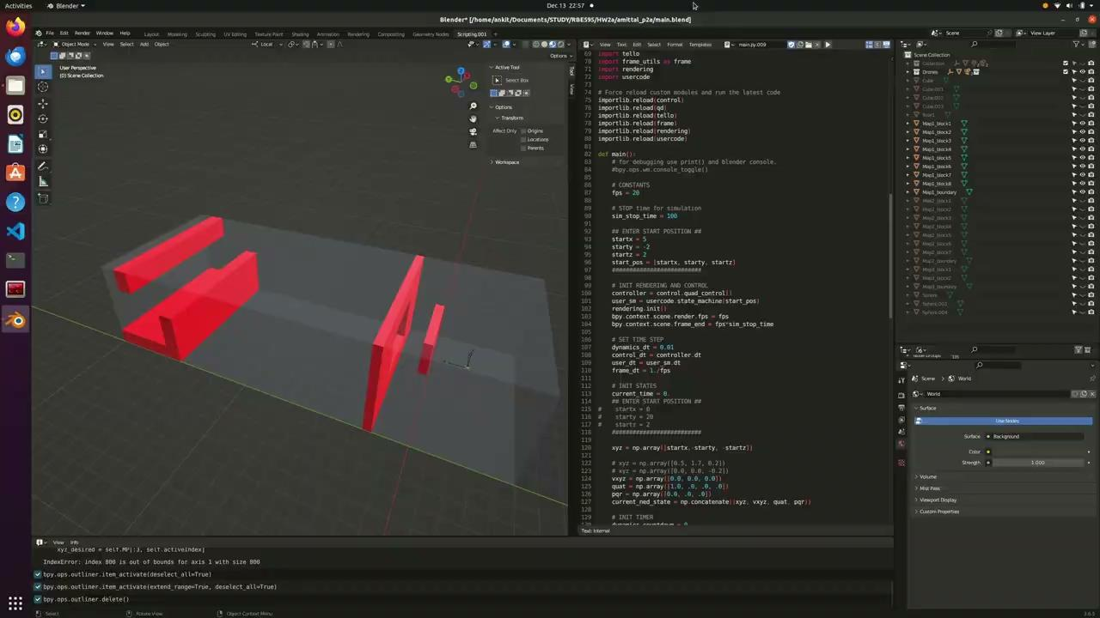
3x

Slide 18
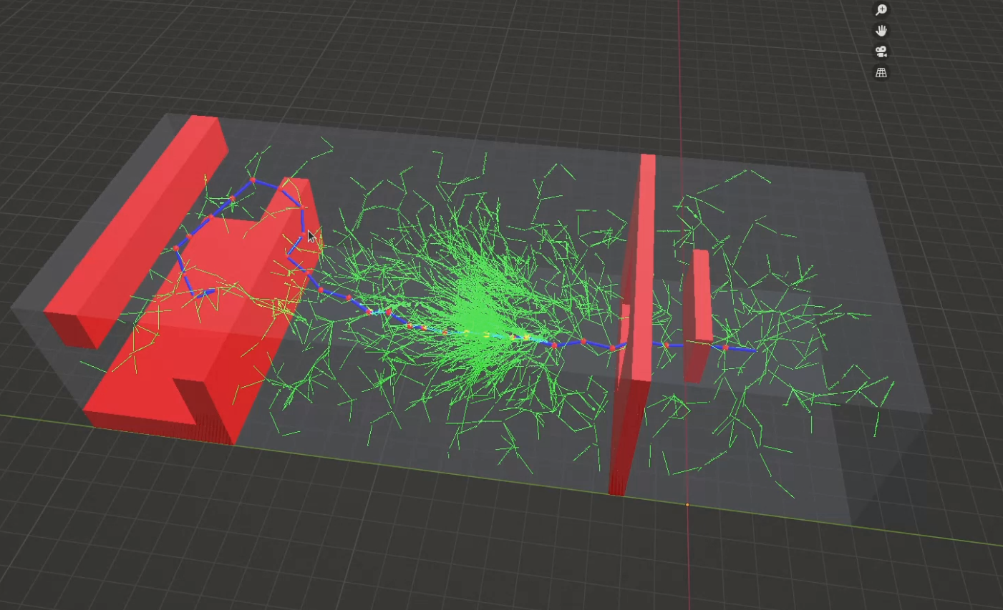
Informed RRT* Visualization

